Slide 1
Sumit vaidya
roll no:- 2759

Slide 2
INTRODUCTION
Microsoft Azure is a cloud computing platform that provides a wide variety of services that we can use without purchasing and arranging our hardware.
Microsoft Azure is a growing set of cloud computing services created by Microsoft that hosts your existing applications, streamline the development of a new application, and also enhances our on-premises applications.
Azure provides a wealth of cloud-based services like remote storage, database hosting, and centralized account management. Azure also offers new capabilities like AI and Internet of Things (IoT).

Slide 3
History Of Microsoft Azure
Microsoft Azure began in the mid-2000s as an internal initiative codenamed Project Red Dog. At the time, Amazon had already launched its cloud computing service, and Microsoft was rushing to catch up.
Since then Microsoft has continued to expand its cloud capabilities specially in compute storage domain.
It also added support for a wide variety of programming languages, frameworks and operating systems, including Linux — something that once would have been unthinkable for a Microsoft product.
Recognizing that its cloud computing service had moved far beyond Windows, the company renamed Windows Azure as Microsoft Azure in April 2014

Slide 4
Availability Zones And Set
Generally, every Azure region consists of multiple data centers located at different physical locations.
Azure availability zones are physically separate locations within each Azure region that are tolerant to local failures.
Azure availability zones are connected by a high-performance network with a round-trip latency of less than 2ms.
Azure provides the most extensive global footprint of any cloud provider and is rapidly opening new regions and availability zones.

Slide 5
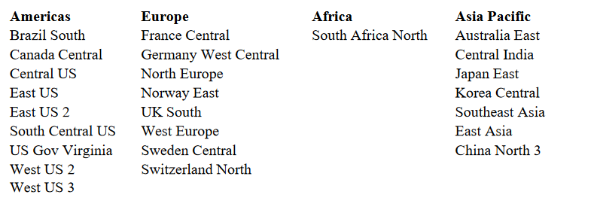
The following regions currently support availability zones

Slide 6
Types of Cloud
Public Cloud: Public cloud is open to all to store and access information via the Internet using the pay-per-usage method.
In public cloud, computing resources are managed and operated by the Cloud Service Provider(CSP).
Example: Amazon elastic compute cloud (EC2), IBM SmartCloud Enterprise, Microsoft, Google App Engine, Windows Azure Services Platform.

Slide 7
Types of Cloud
Private Cloud: Private cloud is also known as an internal cloud or corporate cloud
It is used by organizations to build and manage their own data centers internally or by the third party.
It can be deployed using Opensource tools such as Openstack and Eucalyptus.
Example: Private cloud of the organisation.

Slide 8
Types of Cloud
Hybrid Cloud : It is a combination of public and private cloud.
Hybrid cloud is partially secure because the services which are running on the public cloud can be accessed by anyone, while the services which are running on a private cloud can be accessed only by the organization's users.
example: Google Application Suite (Gmail, Google Apps, and Google Drive), Office 365 (MS Office on the Web and One Drive), Amazon Web Services

Slide 9
Advantages of Azure
High Availability: It refers to the quality of computing infrastructure which allows it to continue functioning, even when some of its components fail.
Data Security: Azure provides many of the things to secure data over the cloud- like Microsoft Defender for Cloud, Key Vault, Azure Information Protection, and many more.
Scalability: Azure provides 2 types of scalability i.e. Vertical and Horizontal scaling to tackle the load by changing the capacity of resources or by adding the resources.
Cost-Effective: Azure provides different pricing models that can help to save costs.

Slide 10
Disadvantages of Azure
Requires Platform Expertise: A common mistake, on-premise servers compute power does not translate equivocally in the cloud but can potentially cost businesses.
Requires Management: As Azure provides many of the platforms so it needs to be expertly managed and maintained which includes patching and server monitoring.

Slide 11
CONCLUSION
As Azure is a Pay as you go model, you only pay for the services which you are using in that specific time. Hence its cost effective.
As Azure has multiple regions and availability zones the failed services can be started within seconds during disaster recovery.
Azure SQL Database Managed Instance is recommended by default when migrating your relational databases from existing applications to Azure.

Slide 12
THANK YOU

